Slide 1
Fundamental Data Structures
Anime Character Simulation Battle Arena
Viktor Logodazhki
Course Project Presentation
10.12.2023

Slide 2
Anime Character Simulation Battle Arena
This presentation introduces the Anime Character Simulation Battle Arena, a game where users can simulate battles between custom or pre-loaded anime characters based on their stats. The presentation covers character creation, the use of pre-loaded characters, battle simulation, the sorting algorithm used to rank characters, data structures and memory management.

Slide 3
Introduction
What is Anime Character Simulation Battle Arena about? The idea can be summed up into two points.
A game where users can simulate battles between custom or preloaded anime characters based on their stats.
To climb the leaderboard by having the highest DPS.

Slide 4
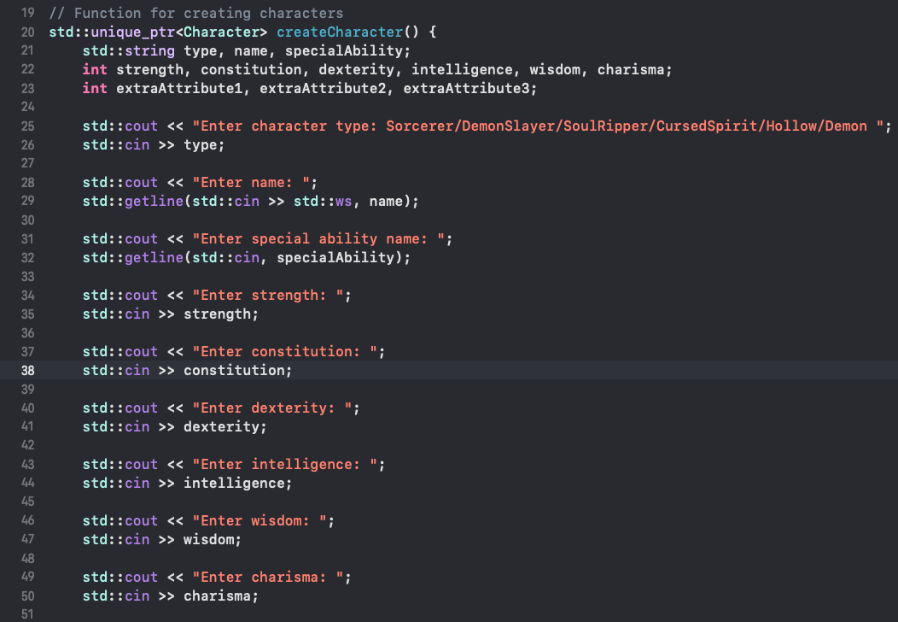
Character Creation
Character creation process:
Players can create their own characters by choosing from various types and customizing attributes like strength and intelligence. This feature allows for creativity and strategy in designing the ideal warrior.

Slide 5
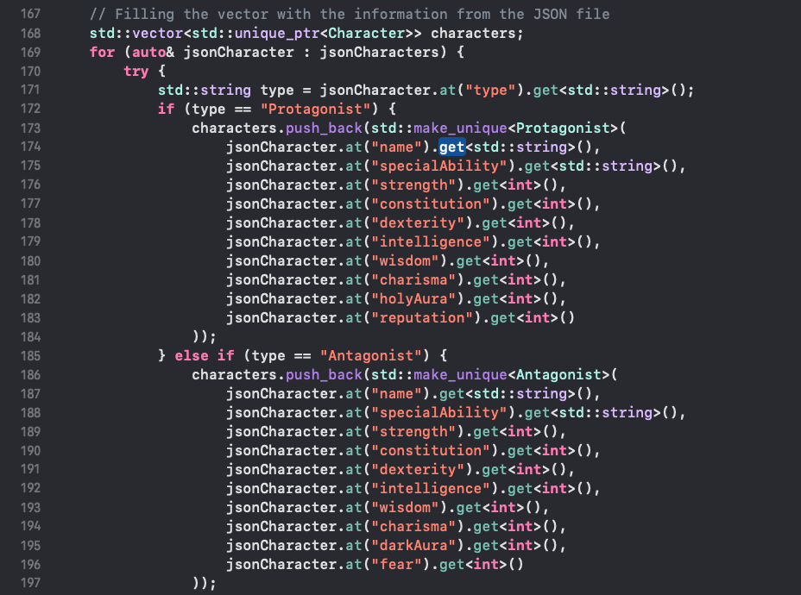
Pre-loaded Characters
If the user chooses to not create characters, he can play with the default ones.
Those characters come from a JSON file allowing for easier readability and editing.

Slide 6
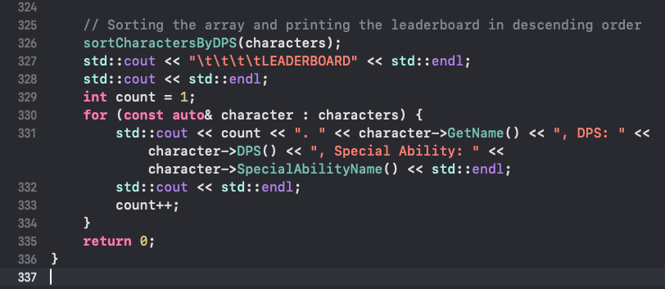
Battle Simulation
Battles in the game are simulated based on the DPS of the characters, focusing on strategy rather than visual combat.
The DPS is the ultimate stat for every character. The winner is determined based on who has higher DPS.

Slide 7
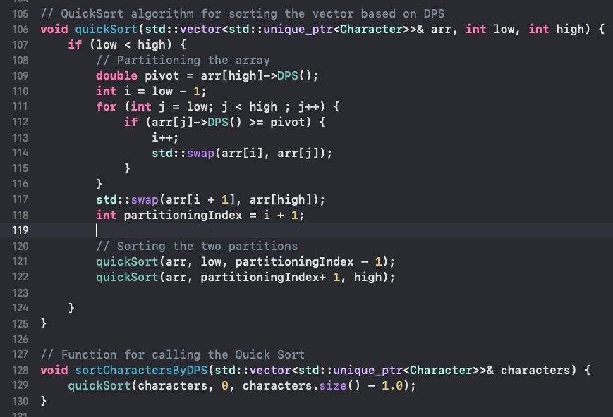
Sorting Algorithm - QuickSort
The leaderboard is organized using QuickSort, a fast and efficient sorting algorithm.
By selecting a 'pivot' point and sorting characters around it, based on the DPS of each character, QuickSort ensures the most powerful characters rise to the top.
With a complexity of O(n log n), it's the ideal algorithm for real-time ranking.

Slide 8
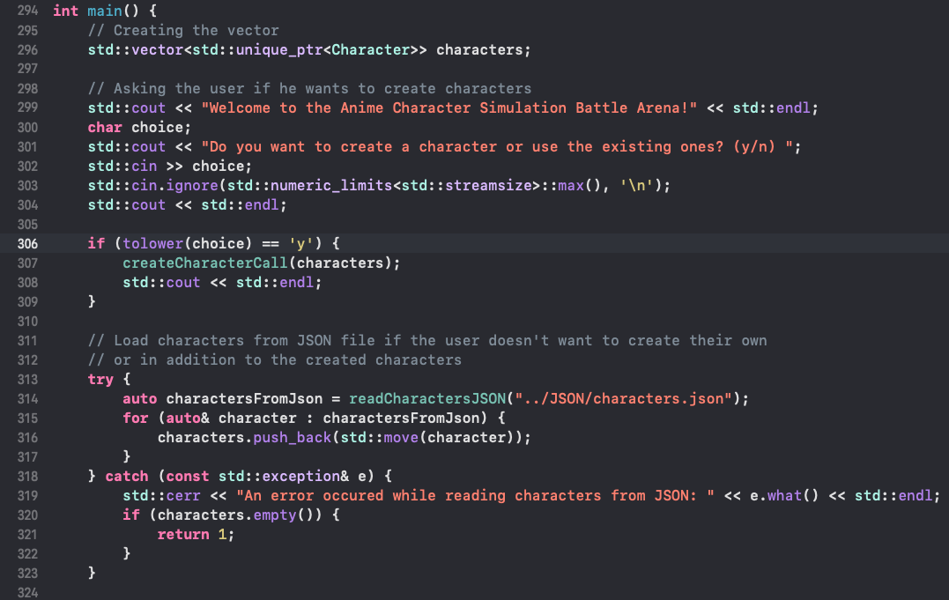
Data Structures and Memory Management
Characters are stored in a dynamic array (vector), allowing for flexible management of the character list.
Memory is managed using smart pointers, ensuring resources are freed when no longer needed, preventing leaks.
These modern C++ techniques ensure the program is both efficient and robust.

Slide 9
Thank you for your time and attention! 😊

